Slide 1
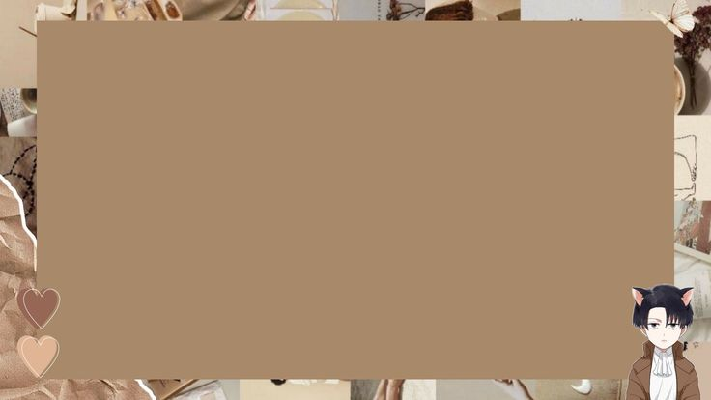
CONVERT NORMAL IMAGE TO SKETCH
IMAGE USING PYTHON

Slide 2
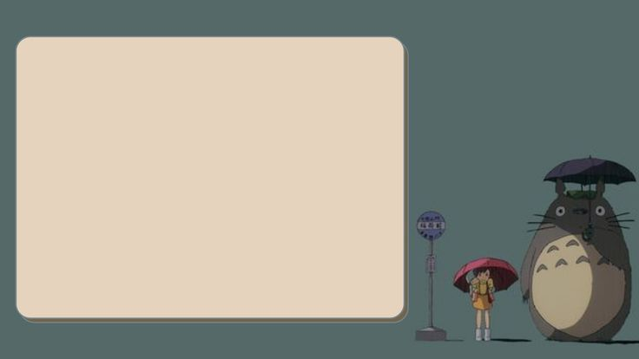

INTRODUCTION
.In this project, we implemented a system to generate pencil-drawing style images from photographs. The system has two main stages. Given a photo as input, it first generates a stroke layer to represent the shapes on the image, imitating painters sketching the contours. Then it produces tonal textures, imitating the hatching process when painters depict brightness and shades with pencils. Finally the two layers are combined to synthesize pencil drawing.

Slide 3
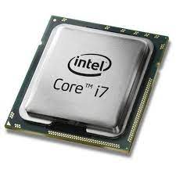




REQUIREMENTS
Software
Hardware
Visual studio code
Python(IDLE)
Image
Terminal
Processor
Windows or MAC
CPU and GPU
HDD free space

Slide 4
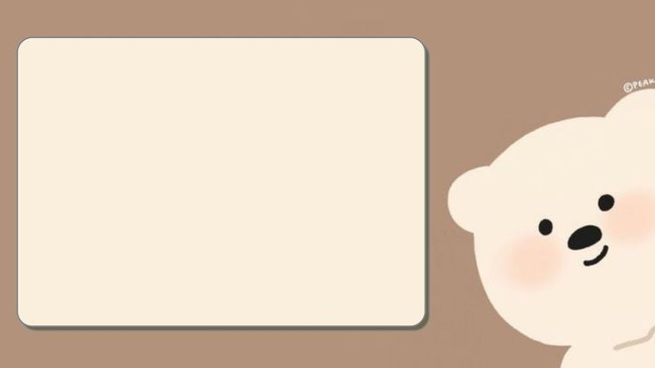

REQUIREMENTS
For this project we required

Slide 5
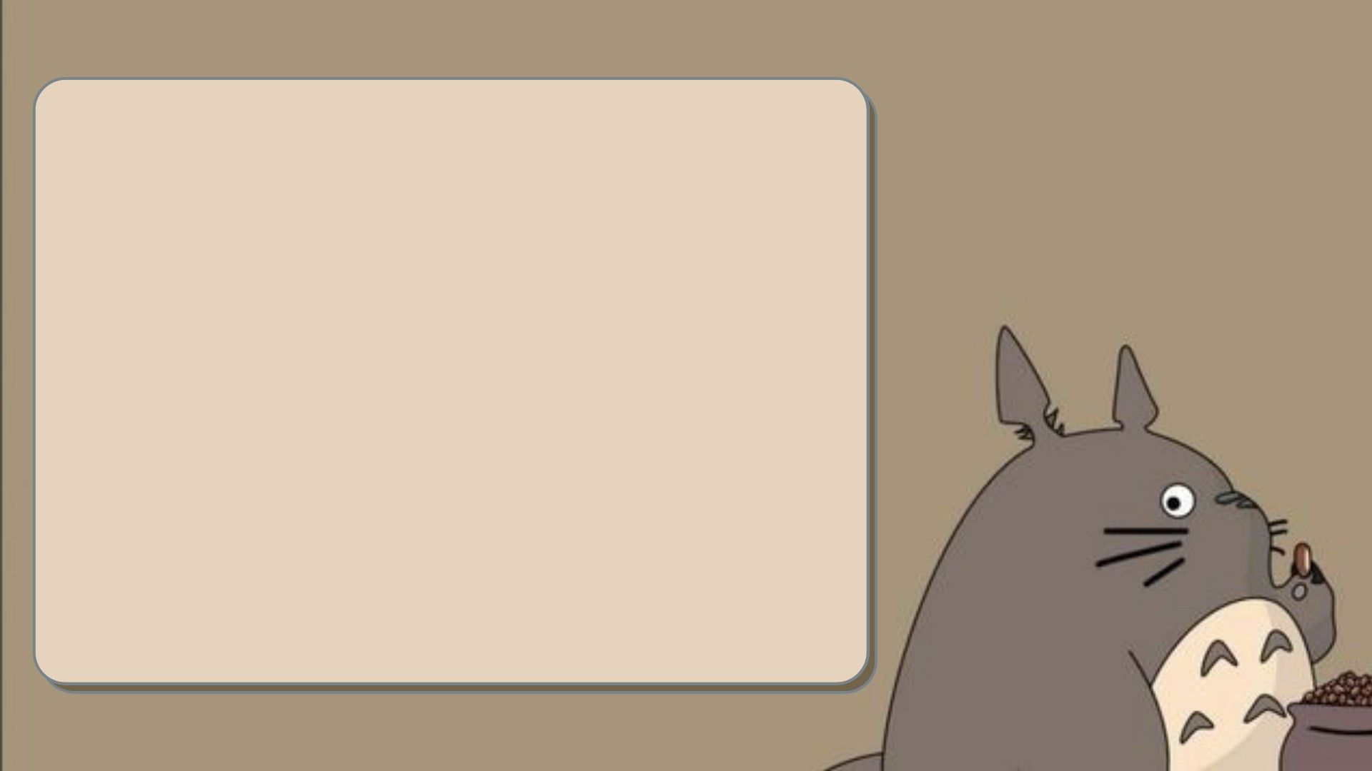
ADDING SELFIE CAMERA
1.Create window
2. Create selfie button and sketch button to the window
3. Now click on selfie button
4.The web cam will be open on another window
5.For capturing the image ….press the S button
6.For closing the cam …..press the Q button
7.Now choose the image from the folder..
8.Convert it into pencil sketch…….

Slide 6

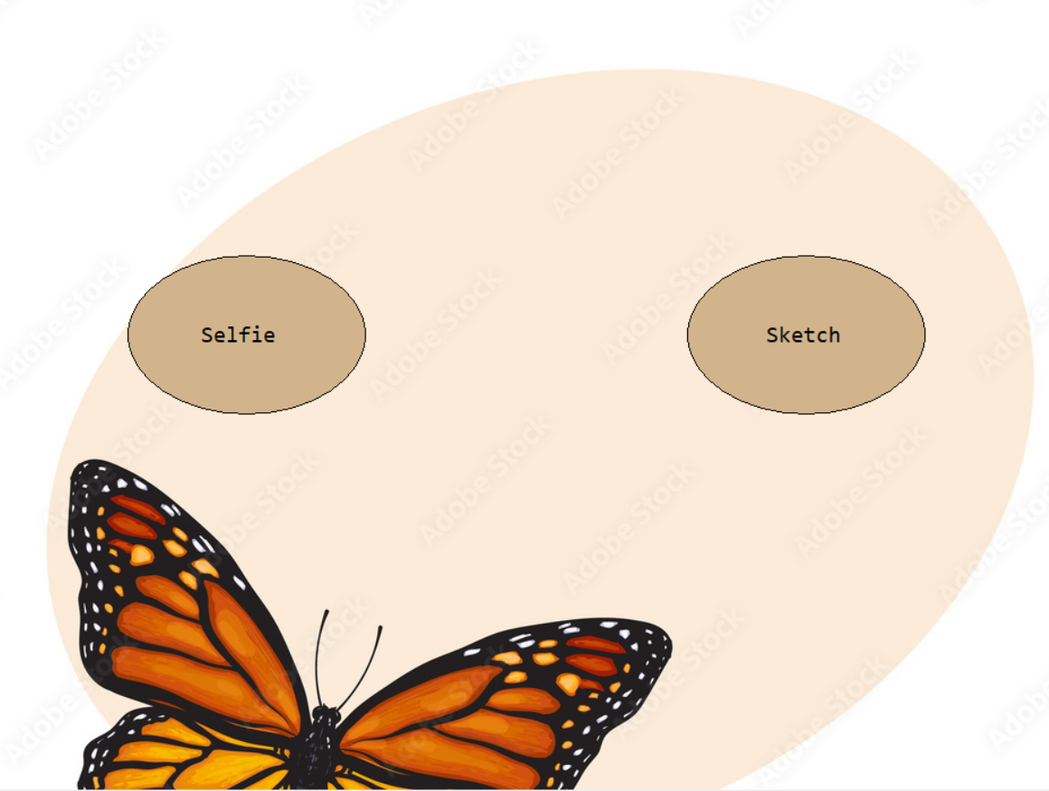
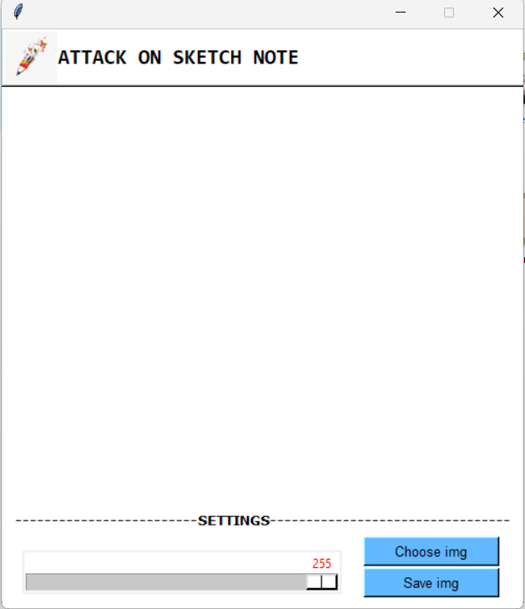
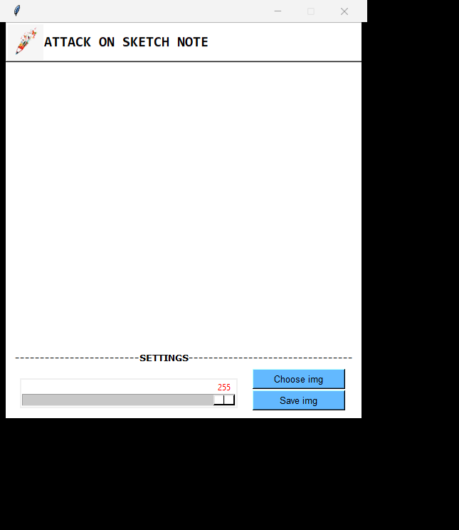
AFTER EXECUTION OF THE CODE

Slide 7

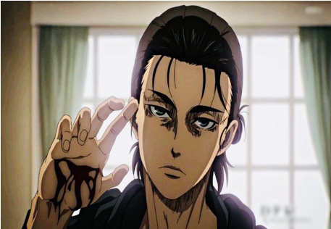
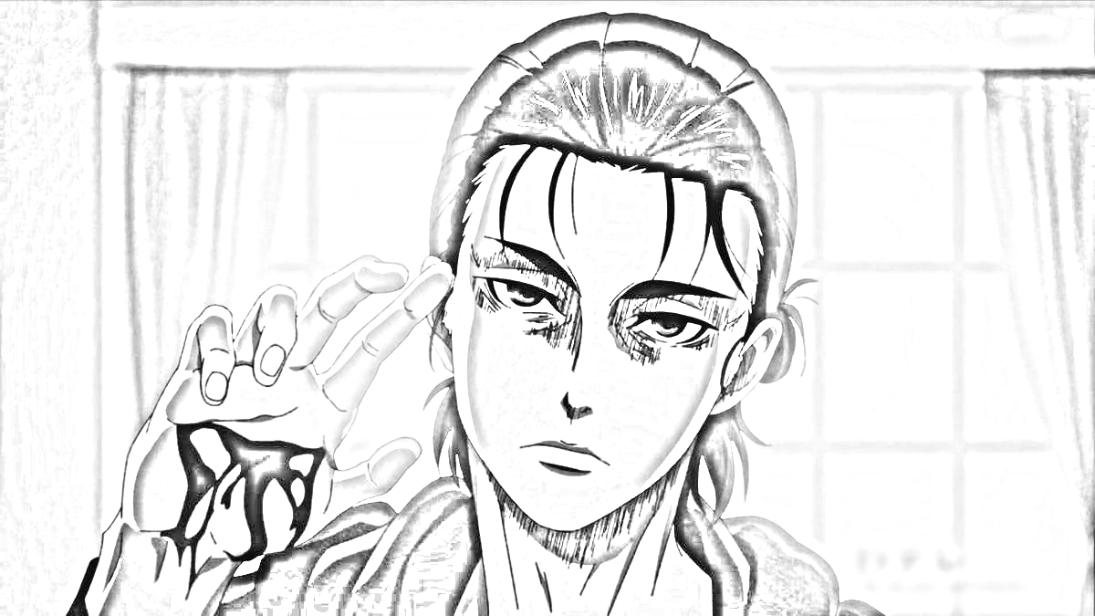
INPUT
OUTPUT

Slide 8


